Slide 1

Name: Mohammad Shahed Akhtar Email: sm57349n@pace.edu Date: October 31st 2023 Class:CS667 : Practical Data Science Program Name: MS in Data Science
Health Insurance Charge Analysis

Slide 2
Agenda
Executive Summary
Project Plan
Data Overview
Exploratory Data Analysis(EDA)
Methods
Findings
Recomendations
Appendix

Slide 3
Data Section

Slide 4
Data Source: Kaggle Sample Size:1338 X 7 Data Excluded: Personal info Time Period: January 2022 to September 2023 Assumptions: The data is considered true for all regions

Slide 5
Executive summary
Problem: Analyze the "Health Insurance Charges" dataset to identify factors influencing insurance costs, develop predictive model, and provide data-driven recommendations for cost optimization in the healthcare insurance sector.
Solution: Cleanse and preprocess data, conduct exploratory analysis, develop predictive models, segment individuals based on risk, propose cost-saving strategies, and provide targeted policy recommendations for optimizing health insurance charges in the healthcare sector.

Slide 6
Exploratory Data Analysis(EDA)

Slide 7
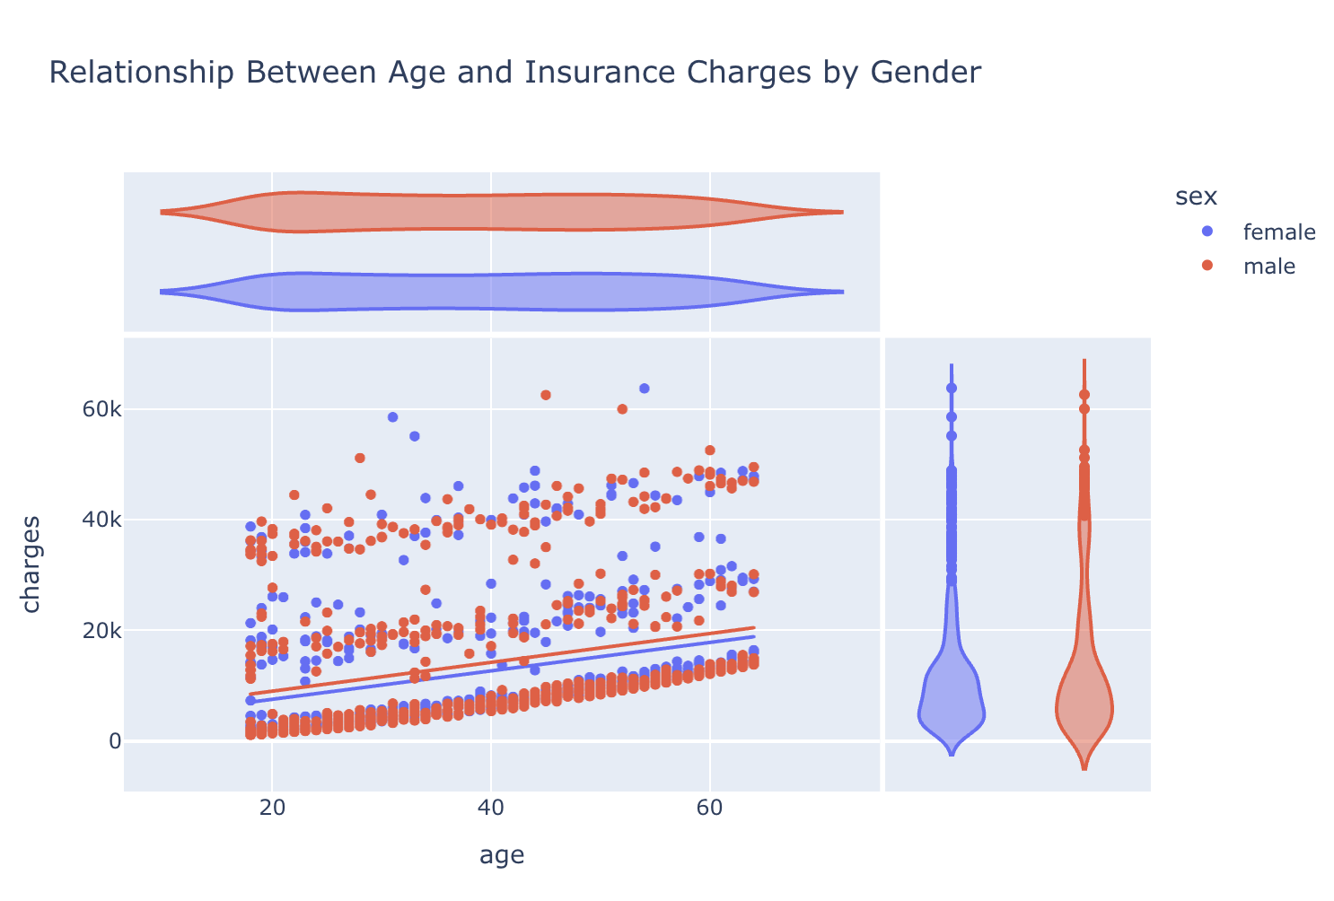
How does Insurance Charges vary across the age?

Slide 8
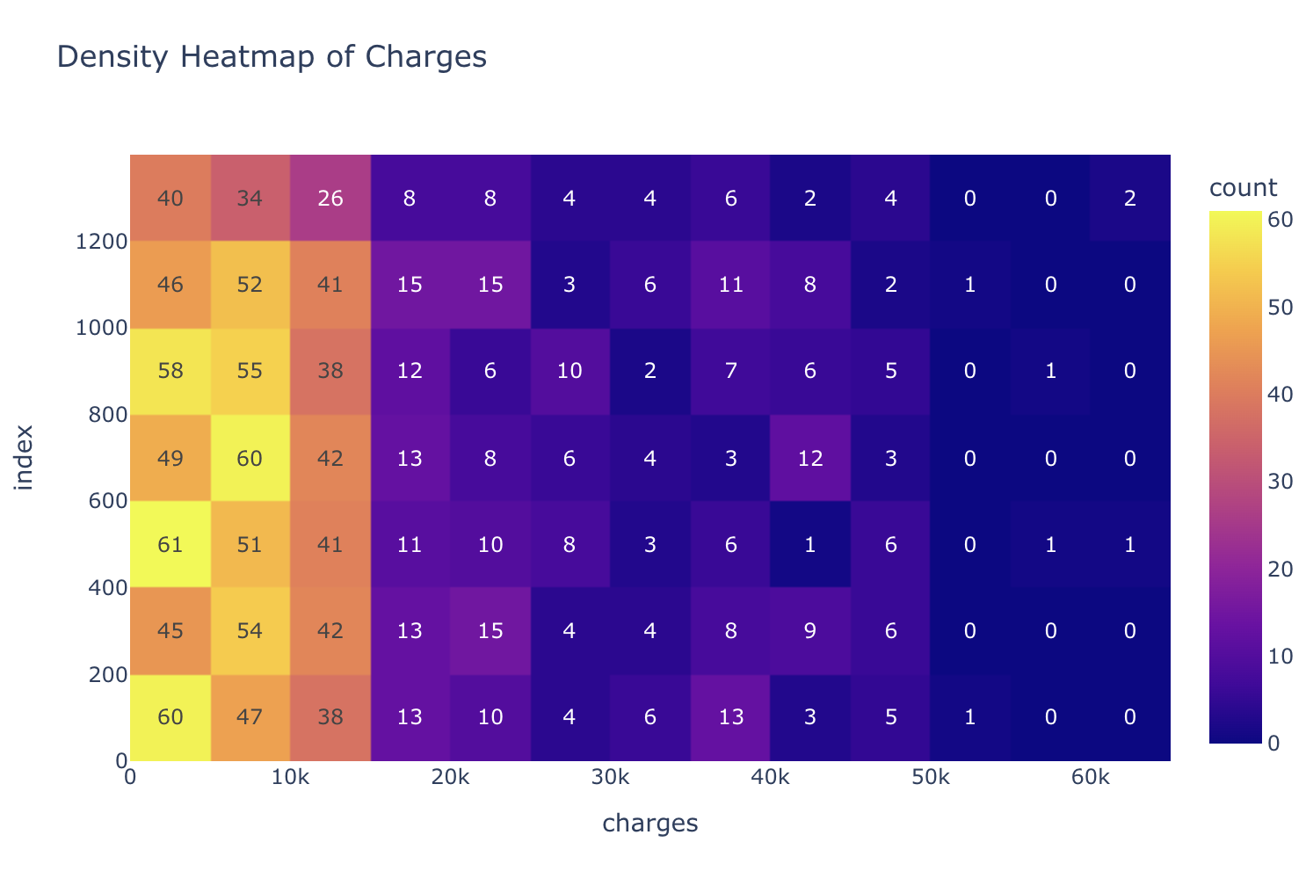

Slide 9
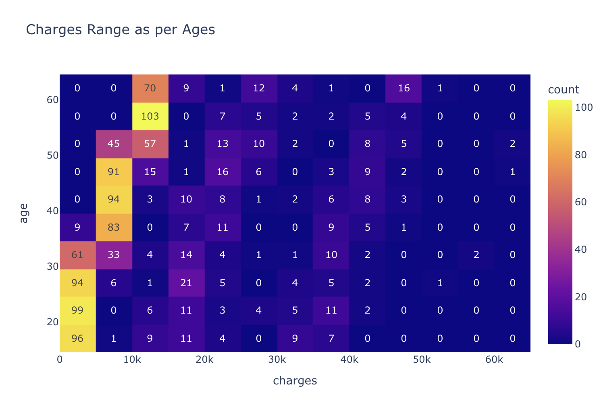

Slide 10
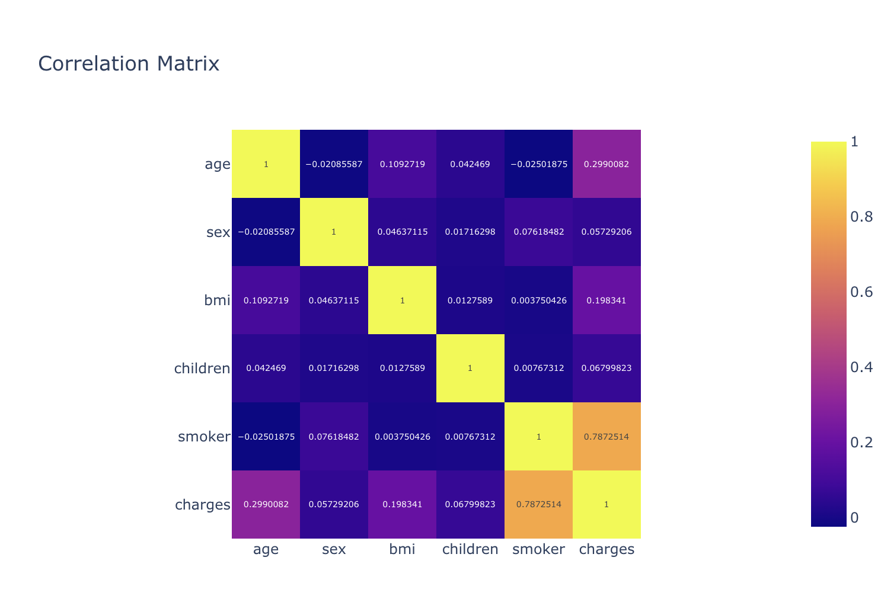

Slide 11
Modeling Methods

Slide 12
Outcome Variable: Health Insurance Charges (charges)
Understanding and predicting the real costs individuals face for health coverage—the money you spend on your health.
Features Considered:
Age
Smoking Status
Region

Slide 13
Model Type: Linear Regression
Rationale: Let's say you're buying a car. The price of the car might depend on its age, the mileage it has, whether it's fuel-efficient, and where you're buying it. Similarly, our model looks at different factors (like age, smoking, and region) to predict health insurance charges. It helps us understand how each factor influences the overall cost, just like the age and mileage influence the price of a car.

Slide 14
Findings

Slide 15
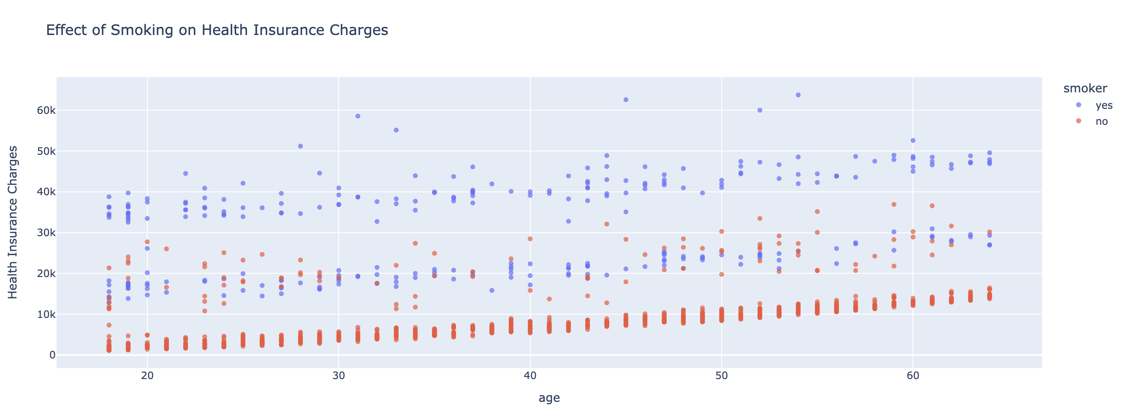
Health insurance charges are much more dependent on that whether the person is a smoker or not

Slide 16
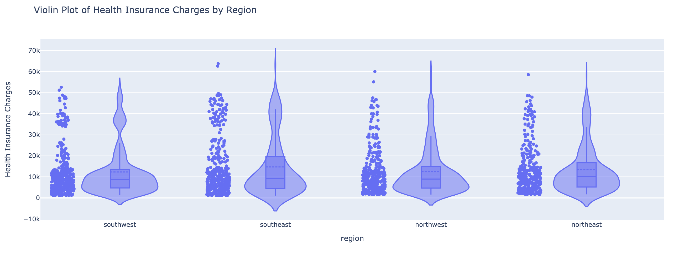
The analysis reveals that where you live (region) can influence health insurance charges, showing that different areas may have distinct patterns in healthcare costs.

Slide 17
Recommendations

Slide 18
Recommendations
1. Smoking Drives Higher Costs:
Business Insight:
Smokers face significantly higher health insurance charges compared to non-smokers, directly impacting overall insurance expenses.
Actionable Step:
Encourage and support smokers in quitting through wellness programs, potentially reducing long-term healthcare costs.
2. Diverse Costs Across Regions:
Business Insight:
Health insurance charges vary noticeably across regions, requiring tailored strategies to address unique healthcare landscapes.
Actionable Step:
Investigate regional factors influencing costs and consider adjusting insurance plans for each region to optimize pricing and enhance competitiveness.

Slide 19
Next steps
1. Explore More Advanced Models:
Look into smarter techniques to better understand what factors affect insurance costs.
2. Consider More Data:
Think about collecting more information to get a fuller picture of why insurance costs are the way they are.

Slide 20
Appendix

Slide 21
Model Type:
Linear Regression
Linear regression assumes a linear relationship between the independent variables and the dependent variable. Mathematically, it can be represented as:
Y=β0​+β1​⋅age+ β2 ⋅bmi+β3​⋅smoker+β4​⋅region+ϵ
Where:
Y is the dependent variable (charges),
β0​ is the intercept,
β1​,β2​,β3​,β4​ are the coefficients.
age, bmi, smoker, region are the independent variables,
ϵ is the error term.

Slide 22
Applied Level:
Features:
Age: Represents the impact of age on charges.
Smoker: Represents the impact of smoking status on charges (0 for non-smoker, 1 for smoker).
Region: Represents the impact of different regions on charges.
Coefficient Interpretation:
β1​,β2​,β3​,β4​ indicate how much the charges change with a one-unit increase in the corresponding feature, holding other variables constant.
Model Assumptions:
Linearity: Assumes a linear relationship between features and charges.
Independence: Assumes independence of observations.
Homoscedasticity: Assumes constant variance of errors.
Normality of Residuals: Assumes that the residuals are normally distributed.

